Slide 1

Eyetracking Workshop
WS 18/19
Wanja Mössing
November 2018

Slide 2
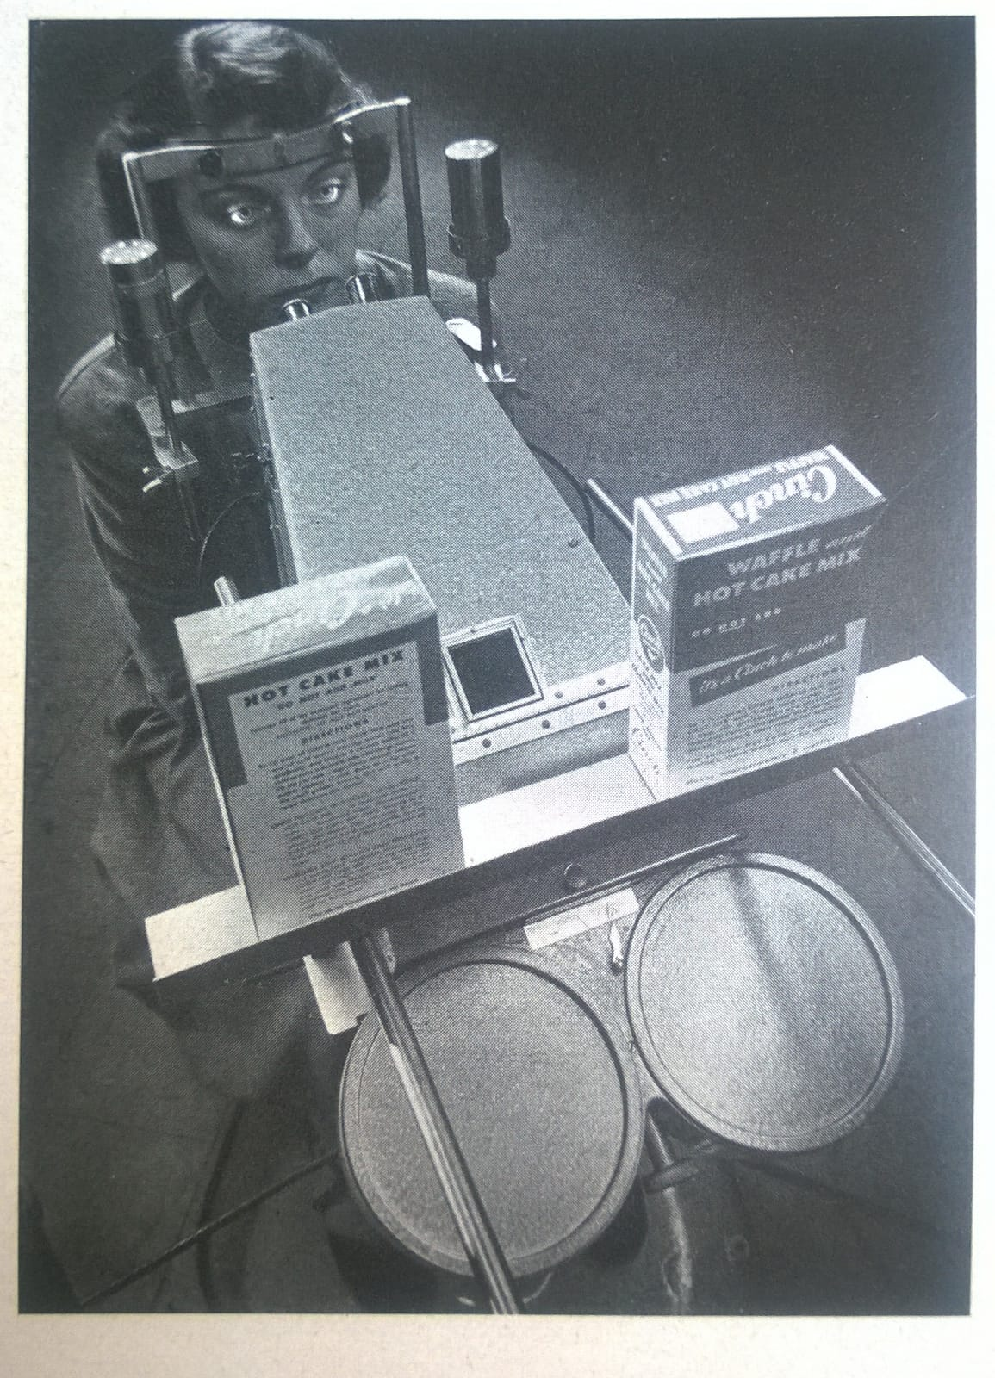
Start
AlternativeTurorialbox
Today we will use 1 Eyetracker!
Create account at sr-support

Slide 3
Today
Short: How does the Eyelink 1k+ work?
How to do gaze control in PTB & Psychopy?
Preparing EEG/ET coregistration in your experiment
Storing behavioral data in your eyetrack
Proper calibration
Converting .edf files: stupid (Matlab) & smart (R)
Preprocessing .edf files in R

Slide 4
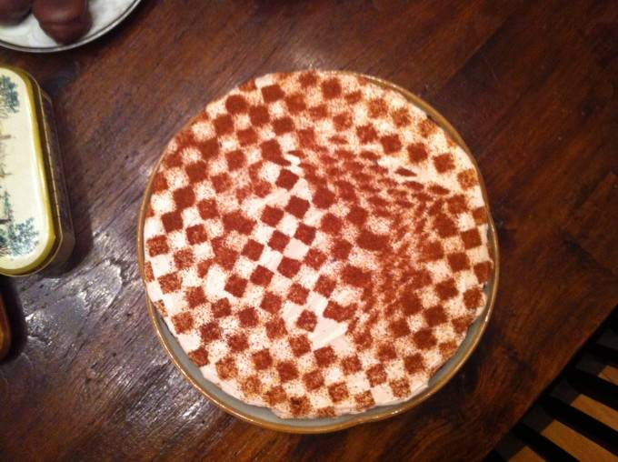
How does the EL1000+ work?
Eyelink

Slide 5
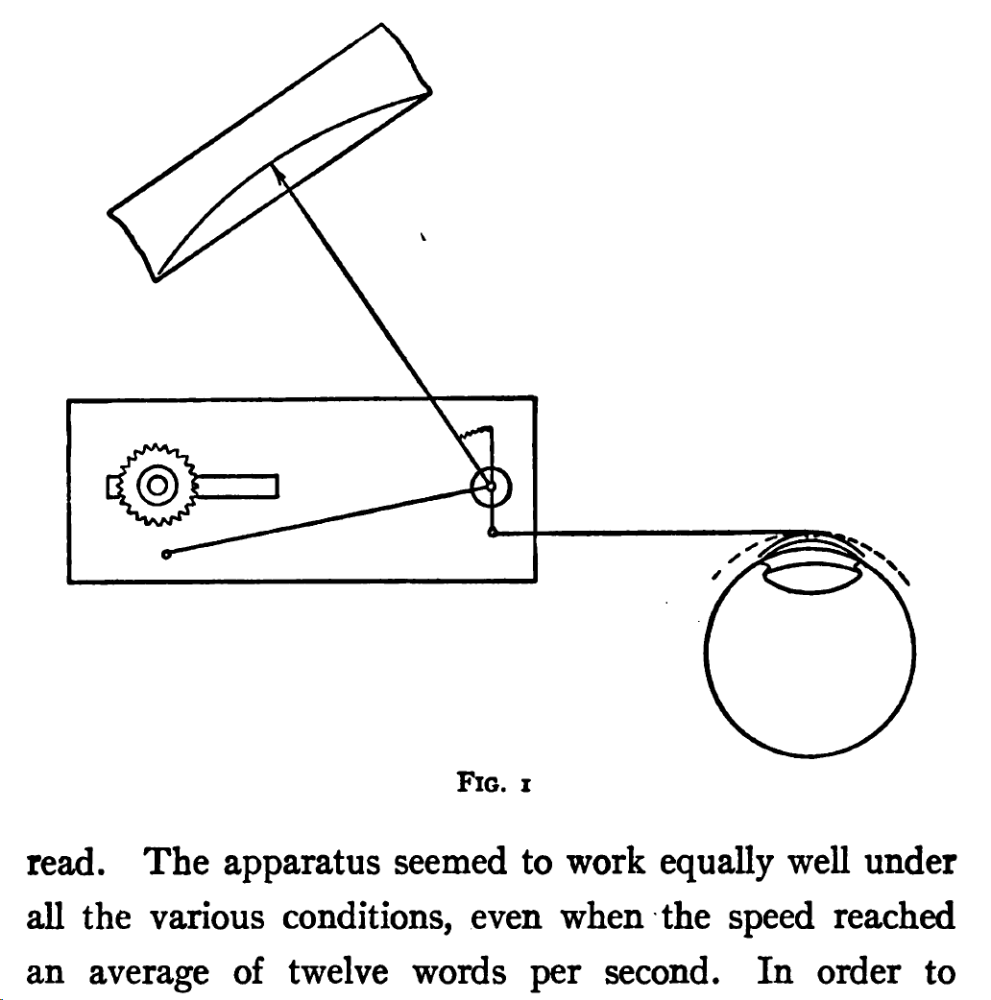
Huey (1908)

Slide 6
EL1k+
Infrared based eyetracker
Infrared light is emitted to the eye
The lens records the eye from another angle
EL-host-PC detects pupil and Purkinje image

Slide 7
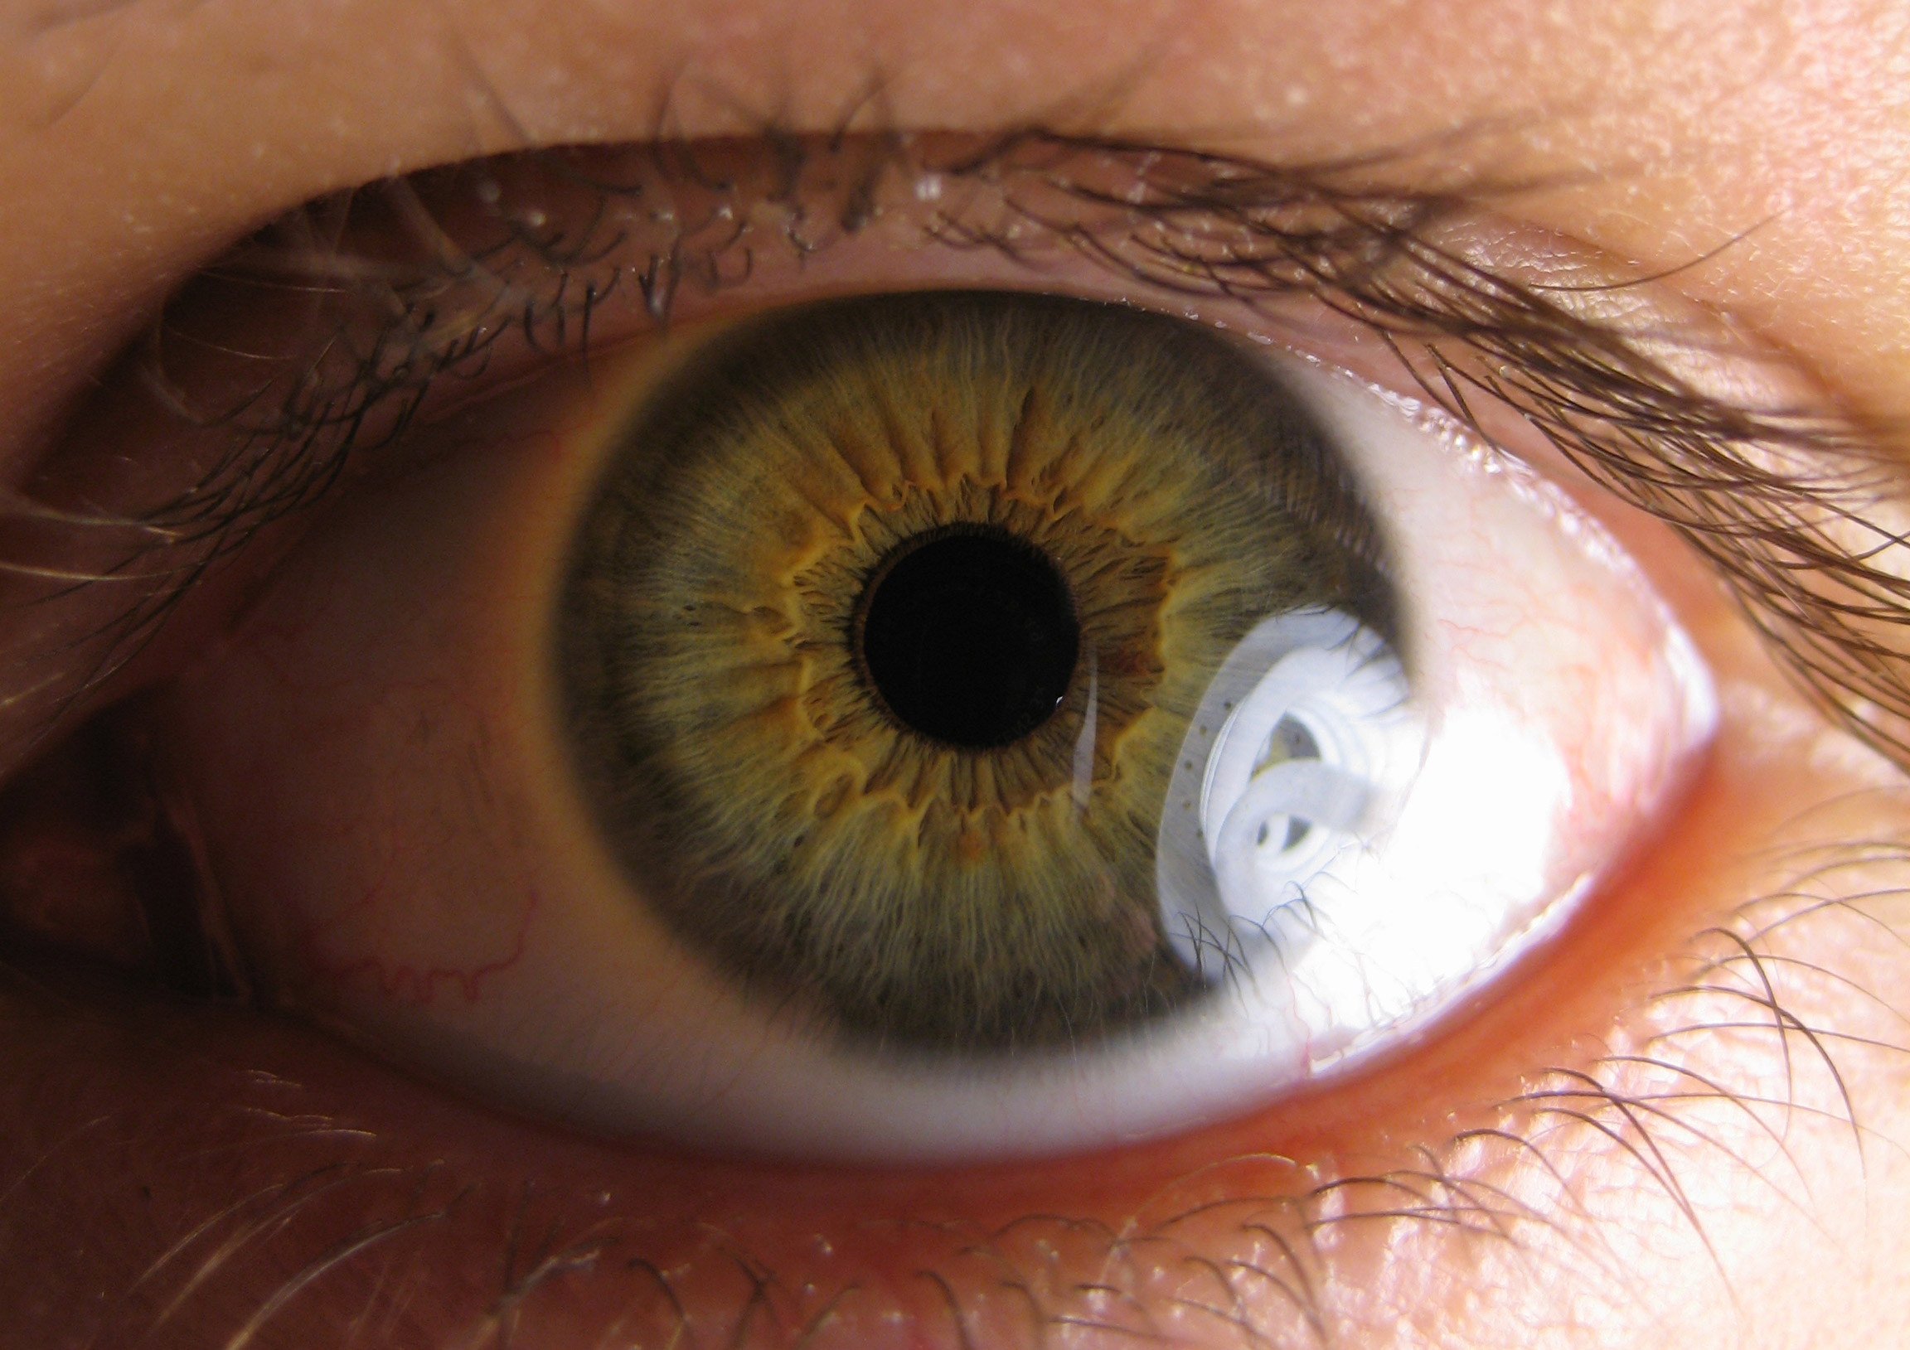
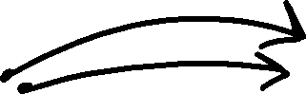

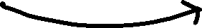

Purkinje
Purkinje images
pupil

Slide 8
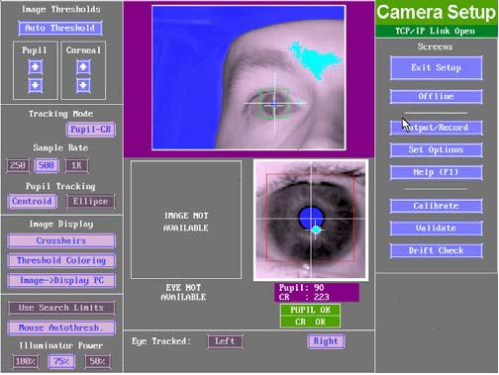

Calibration
Cornea reflection = 1st purkinje image

Slide 9
calibration
Calibration creates constellation-dependent coordinate system
Validation takes similar measurements and checks how much the screen position differs from the system‘s prediction

Slide 10
Check setup
When looking straight, subjects should look at top 25% of screen
Eye-to-monitor distance should be >=1.75*monitor width
Distance tracker<->Eye 40-70cm (ideally 50-55)
Tracker‘s top as close as possible to screens bottom
Tracker should be centered horizontally wrt screen
Illuminator: usually @75%

Slide 11
Good calibration
Usually, centering the tracked eye is best (use big knob)
Click on the tracked eye and make sure the eyelink thinks about it as „right“ or „left“
Tune lense manually
Click ‚a‘ for auto-threshold
Assure that pupil and CR are well filled and (best case) nothing else is highlighted in the same colors.
Try to improve things by manually adjusting thresholds with UP/DOWN and +/-
Have subject look in all corners of the screen and see if the above settings still look good

Slide 12
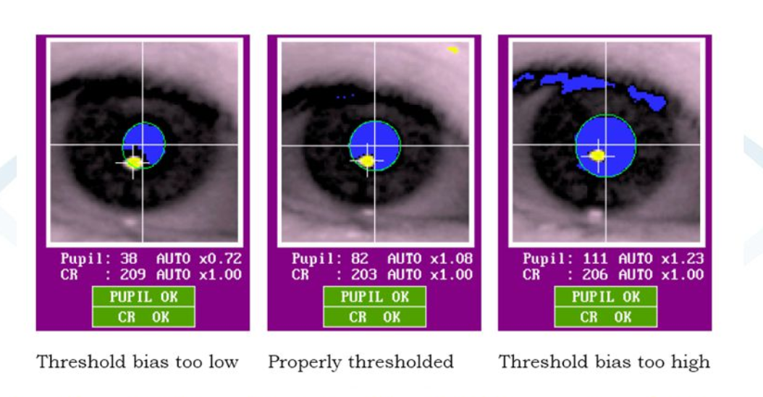
Good calibration
Usually, centering the tracked eye is best (use big knob)
Click on the tracked eye and make sure the eyelink thinks about it as „right“ or „left“
Tune lense manually
Click ‚a‘ for auto-threshold
Assure that pupil and CR are well filled and (best case) nothing else is highlighted in the same colors.
Try to improve things by manually adjusting thresholds with UP/DOWN and +/-
Have subject look in all corners of the screen and see if the above settings still look good

Slide 13
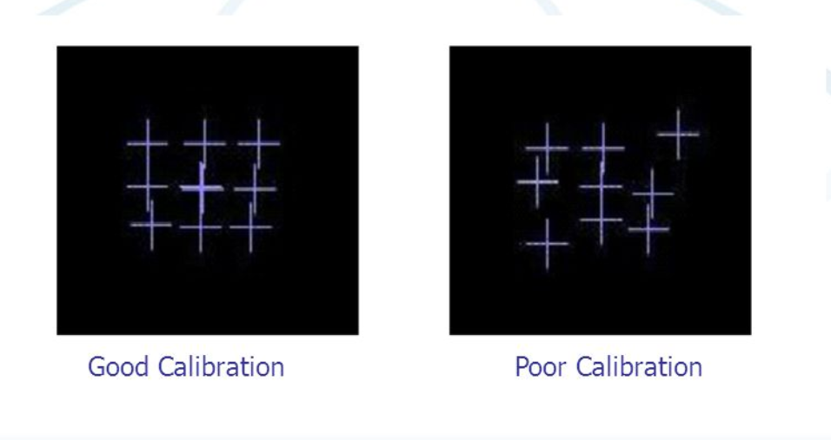
Cali-Vali
9-13 point calibration are most precise
Grid should be horizontally and vertically parallel (approx.)
If not: redo setup

Slide 14
Glasses gone wild
Problem: Glasses reflect IR-light -> tracker thinks ist CR-reflection
Try this:
Ask subject to move chin forward
Adjust table height
Move camera closer to subject (min distance: 40cm!)
Lower position using big knob
Adjust angle of camera
Increase illumination

Slide 15
Ellipse vs Centroid
Two modes of tracking pupil
Ellipse interpolates parts of pupil that are occluded
Centroid uses center of mass
Centroid: Usually best, less noise
Ellipse: Good for people with low eyelids and tiny glasses

Slide 16
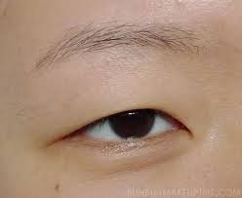
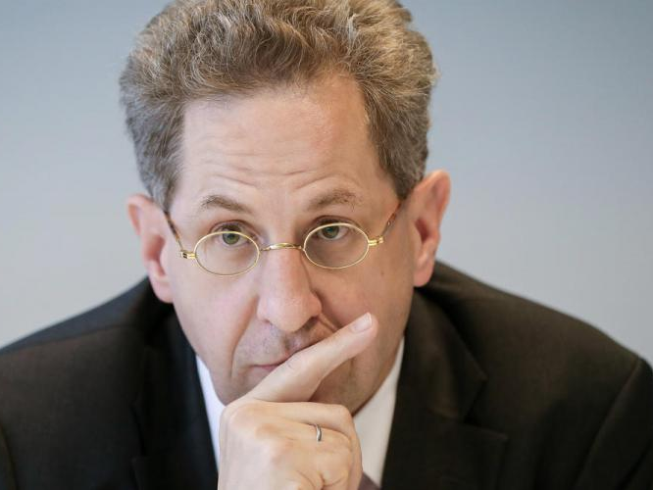
Ellipse vs Centroid
Two modes of tracking pupil
Ellipse interpolates parts of pupil that are occluded
Centroid uses center of mass
Centroid: Usually best, less noise
Ellipse: Good for people with low eyelids and tiny glasses

Slide 17
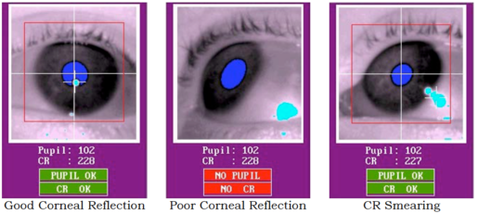
CR smearing
Usually happens when looking at top corners
Increase distance or lower threshold

Slide 18

Software structure
Experiments
Matlab / python

Slide 19
Install this (to record)
SR Developer‘s pack
Psychtoolbox comes with Eyelink toolbox
Psychopy comes with *too outdated* Eyelink module
See my readme on github for how to update (don‘t use pip!)
My set of high-level Eyelink functions
github.com/wanjam/wm_utilities/Eyelink

Slide 20
Install this (to analyze)
SR Developer‘s pack
Matlab:
Coregister EEG/ET: Olaf Dimigen‘s <EYE-EEG>
Eeglab plugin manager is outdated. Use github: olafdimigen/eye-eeg
R:
Parse edf files: Jason Hubbard‘s <edfr>
devtools::install_github(‘jashubbard/edfr‘)
Massage data: Hedderik van Rijn‘s <pR>, my <wmR>
devtools::install_github(‘wanjam/wm_utilities/helper-funs/wmR‘)
devtools::install_github(‘hedderik/pR‘)

Slide 21
SR-dev kit
SR research provides a „developer‘s kit“
Newest version always in forum
Ubuntu: PPA (read instructions *very* careful)
Windows/Mac: zip/dmg
Core of everything (written in C++) → install!
Have a look: sr-support.com

Slide 22
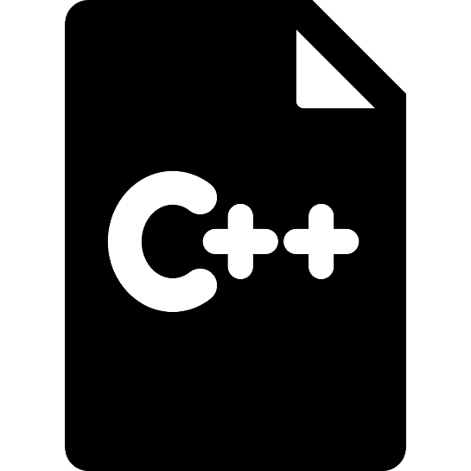

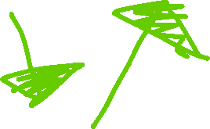




Software structure



EDF datafiles
Analysis
Jason hubbard “edfr”

SR’s developer’s kit
▪

wm_utilities/Eyelink
■
Stimulation PC
Psychtoolbox/Eyelink
Gaze-control

Slide 23
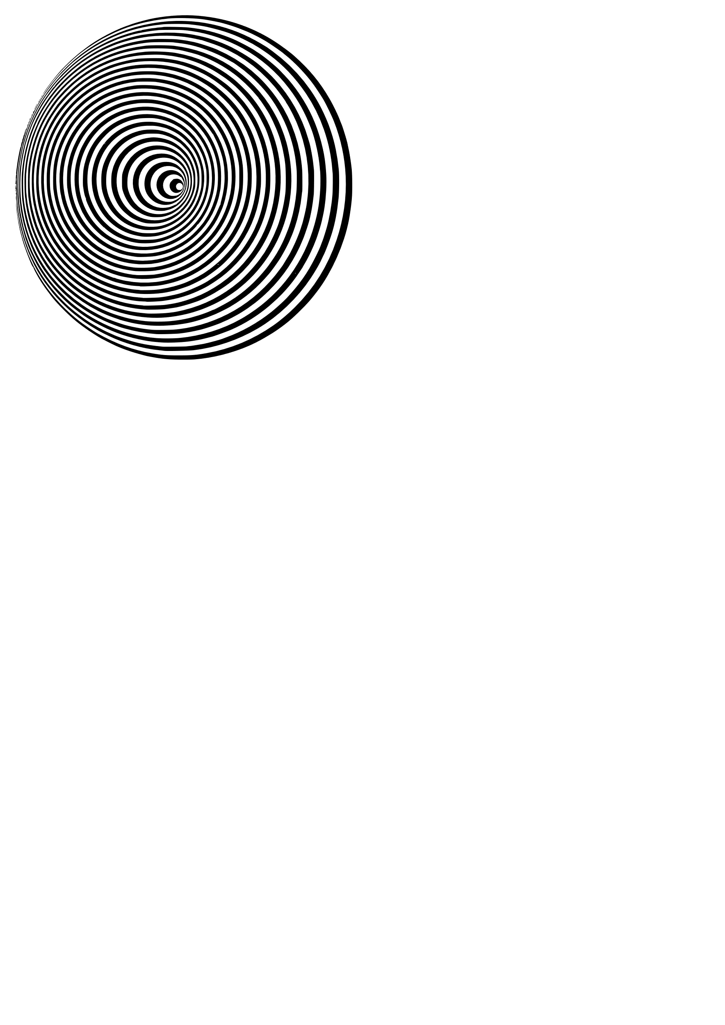
Functions for Experiments
Experiments

Slide 24
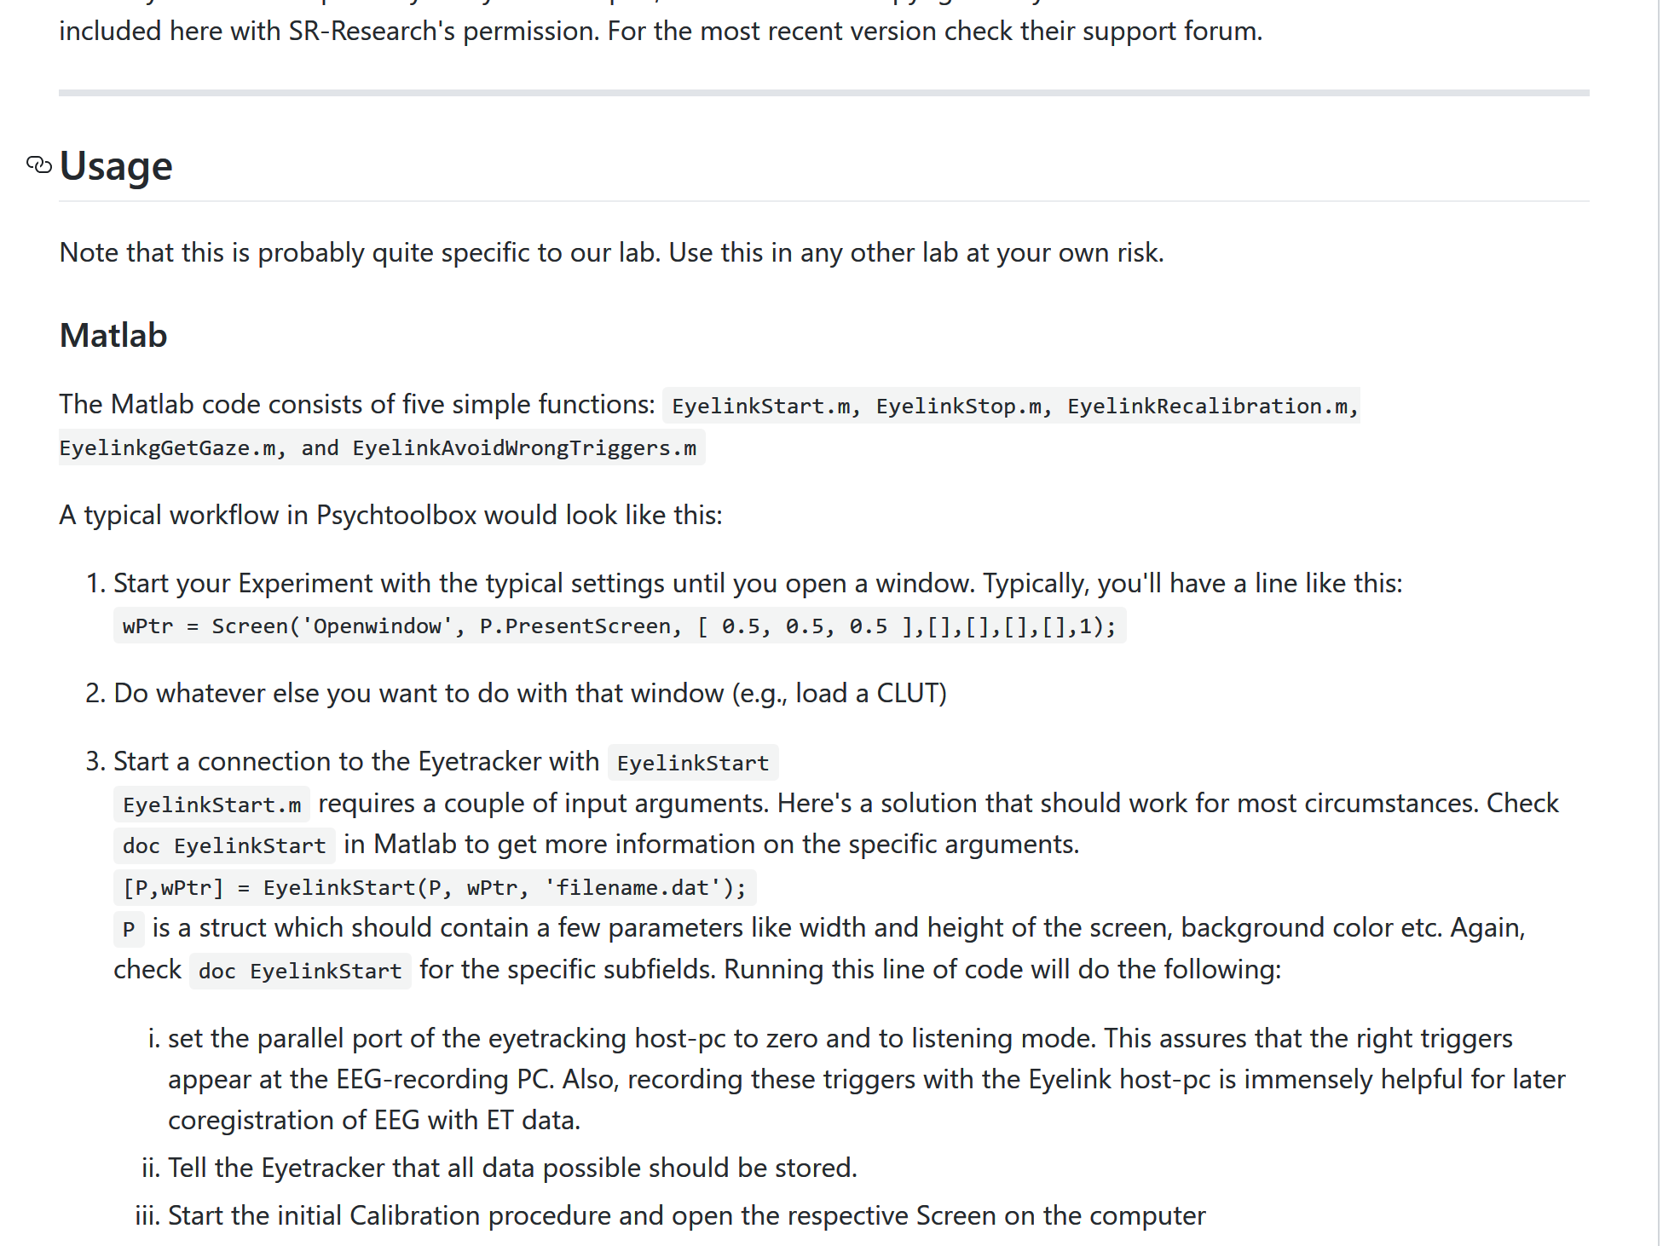
wm_ utilities
Readme online! https://github.com/wanjam/wm_utilities/Eyelink

Slide 25

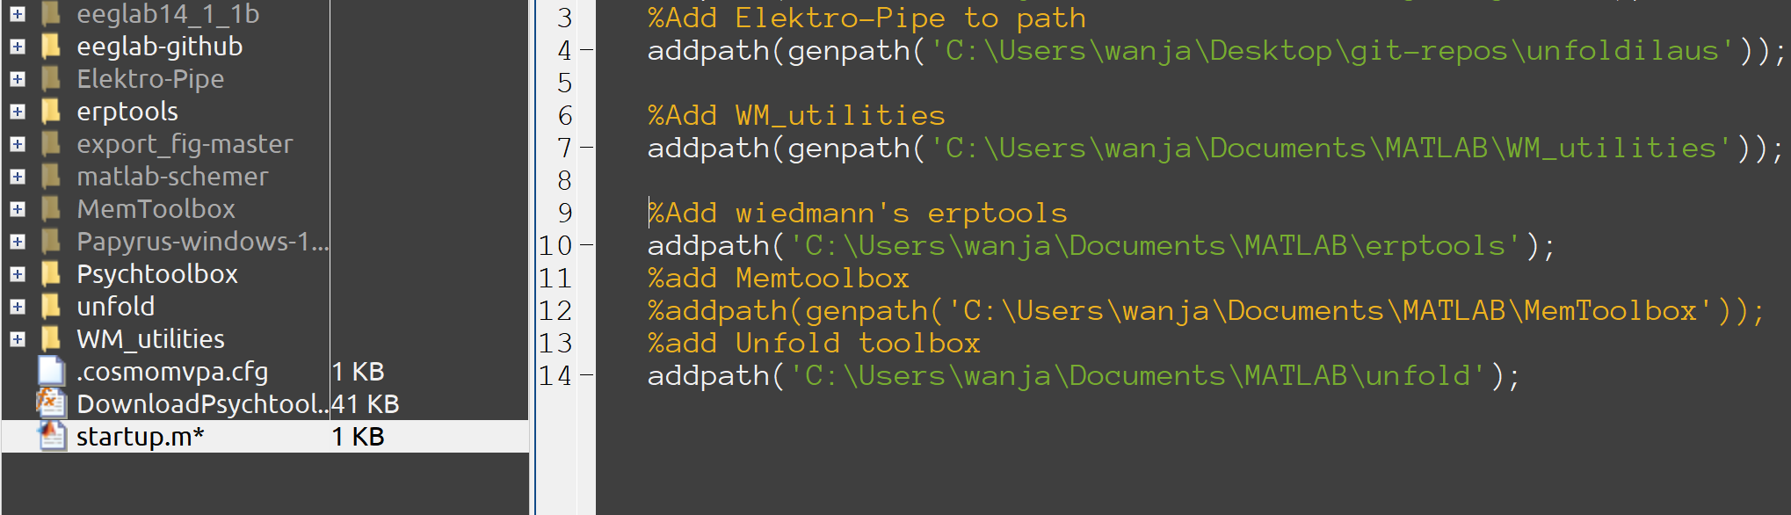
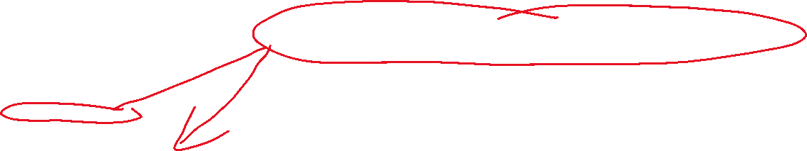
wm_ utilities
I‘ll only talk about Matlab – Same functions for Python!

Slide 26

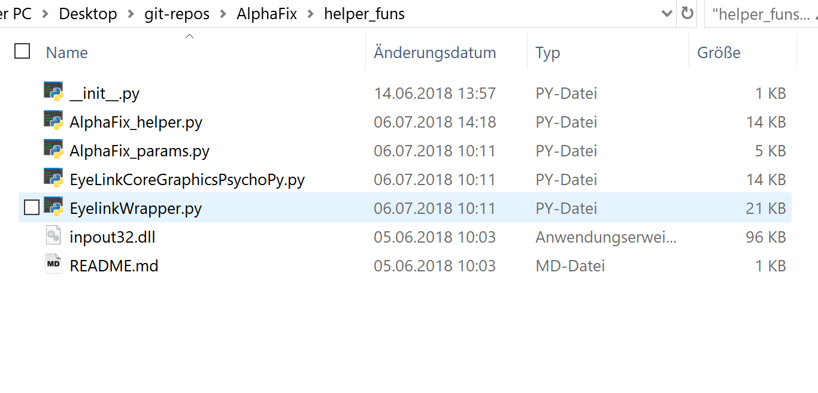
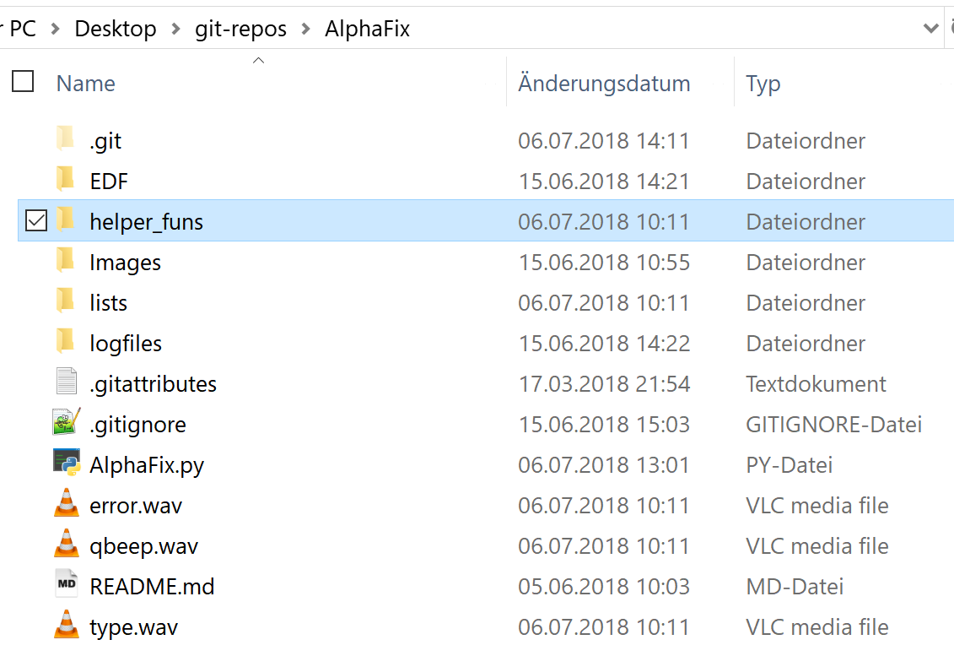
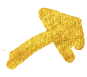
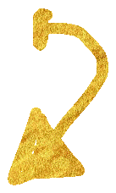
wm_ utilities
I‘ll only talk about Matlab – Same functions for Python!

Slide 27
Connect
[P, wPtr] = EyelinkStart(P, wPtr, “filename“)
→ doc EyelinkStart
P = your structure with parameters
can be empty, can contain extra config stuff
Always back assign P!
Does this:
Starts and configures connection between EL and PC
Opens a file to write to
Defines sampling rate and what to store
Defines locations of calibration points
Nulls the TTL port
Runs an initial calibration

Slide 28
Re-calibrate
EyelinkRecalibration(P)
Recalibrates the Eyetracker
Useful when:
Break
Subject moved a lot and eye is lost

Slide 29
Control Fixation
[didrecal, FixationOnset, hsmvd] = EyelinkControlFixation(P, Tmin, Tmax, loc, maxDegDeviation, eyelinkconnected, pixperdeg, dorecal, Igoreblinks)
Highest possible level in wm_utilities
Does this:
Takes a target location (loc)
Subject has <Tmax> seconds to look at the target
Subject has to look at target for <Tmin> seconds
If not: start a recalibration (If you want that)
Do you want to ignore blinks?

Slide 30
Get Gaze
[x, y, hsmvd] = EyelinkGetGaze(P, Ignoreblinks, OverSamplingBehavior, targetXY, FixLenDeg, eyelinkconnected, pixperdeg)
Lower level: Just get the gaze position and check whether that differs from the last position.
Does this:
Checks if the Eyetracker has a new sample available
If so, return the (x, y) pixel coordinate pair of the current gaze
In addition, check if the current gaze differs more than <FixLenDeg> degree from targetXY. If so, <hsmvd> is true (1).

Slide 31
Behavioral data
[message] = EyelinkSendTabMsg(varargin)
stores behavioral data coregistered with time and ttl into the .edf file
Does this:
Takes as many input arguments as you want
Converts everything to strings
Concatenates everything tab-delimited
Prepends a “<“
Sends <message> to .edf file

Slide 32
Stop recording
EyelinkStop(P, eyelinkconnected)
Finishes recording and puts Eyelink to standby
Does this:
Stops the recording
Copies the final file from the EL-host PC to the stimulation PC
Then puts the Eyelink to standby

Slide 33
Status Notifier
EyelinkNotify(message, eyelinkconnected)
Lower level: Just get the gaze position and check whether that differs from the last position.
Does this:
Checks if the Eyetracker has a new sample available
If so, return the (x, y) pixel coordinate pair of the current gaze
In addition, check if the current gaze differs more than <FixLenDeg> degree from targetXY. If so, <hsmvd> is true (1).

Slide 34
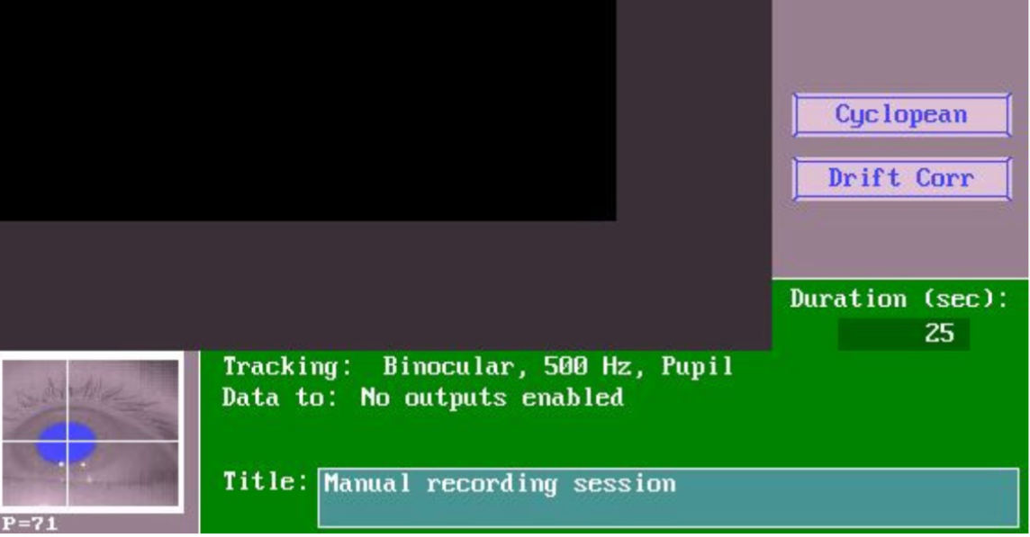

Status Notifier
EyelinkNotify(message, eyelinkconnected)
Lower level: Just get the gaze position and check whether that differs from the last position.
Does this:
Checks if the Eyetracker has a new sample available
If so, return the (x, y) pixel coordinate pair of the current gaze
In addition, check if the current gaze differs more than <FixLenDeg> degree from targetXY. If so, <hsmvd> is true (1).

Slide 35
TTL trigger
EyelinkAvoidWrongTriggers
Prevents EEG-trigger-mess
Should be at the top of your non-eyetracking experiment
Does this:
Checks if the Eyelink-host pc is turned on
Throws an error if that‘s the case

Slide 36
Para-meters
‚eyelinkconnected‘ = boolean – if false, all functions are dummies
Dummymode doesn‘t always work for me, but it‘s worth trying

Slide 37
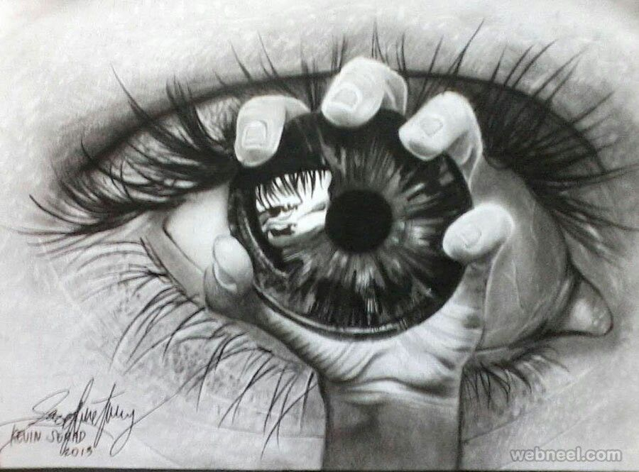
Implement Gazecontrol
DIY

Slide 38
DIY
Open a terminal and run >ptb3-matlab
Go to /home/tutorialbox/Documents/MATLAB/Tutorial/Task
Start the experiment once by running >TutorialExperiment.m

Slide 39
DIY
Add code to start and stop the Eyelink
Display „Ruebezahl“ as status message, right after EyelinkStart
Display the current trial number as status message
Recalibrate after each break.
Control that subjects look at the fixation symbol.
Send „triggers“ (i.e., messages) after all relevant flips.
Store the resulting behavioral data in the .edf
If time: try to make the target‘s position gaze-dependent

Slide 40

Preprocessing
Analyze

Slide 41
What‘s possible?
Coregistration with EEG data:
Fixation Related Potentials → follow EYE-EEG/Elektro-Pipe
Pupil Dilation
Saccades
Fixations
Gazepaths
…
→ Most stuff possible after following this template…

Slide 42
Parse
Matlab
edf2asc: binary available in the terminal (from the devpack)
EYE-EEG
parseyelink(file.asc) ← converts .asc to .mat
pop_importeyetracker(EEG, file.asc) ← coregistration
Elektro-Pipe
func_importEye combines all three and plots quality
Called by prep01_preproc

Slide 43
Parse R
Jason Hubbard‘s edfr uses the devpack‘s C++ code directly
No need for edf2asc
Most sophisticated package for parsing (afaik)
edf.all(), edf.recordings(), edf.events()
= ET-data, Header, TTL

Slide 44
DIY
Open Rstudio in the VirtualBox
You‘ll find a file called tutorial_preprocEDF.R
Let‘s first walk through that…
Challenge:
Set the output time vector relative to fixation onset
Go to line 213. Try to add more info (as added in the experiment)
Add the new info to all necessary lines.

